Slide 1
FINAL PROJECT AIR ticket price prediction
PROBLEM
STATEMENT
This is the data of different airlines of India and the flights are organized between different cities within India. The objective is to build a model that predicts air ticket prices.
BY-
TUSHAR SHARMA

Slide 2
CONTENTS
Univariate Analysis
Bivariate Analysis
Correlation Matrix
Feature Importance
Model Comparison
Feature Scaling Effect
Conclusion

Slide 3
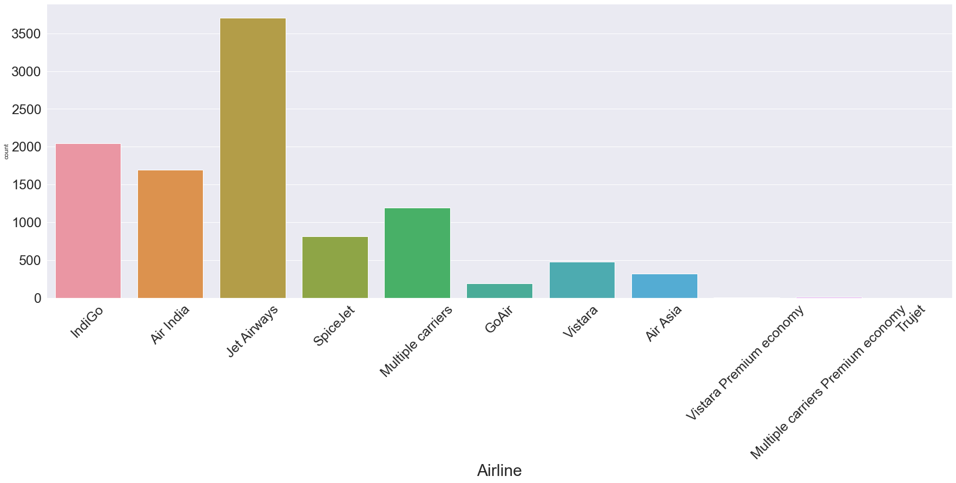
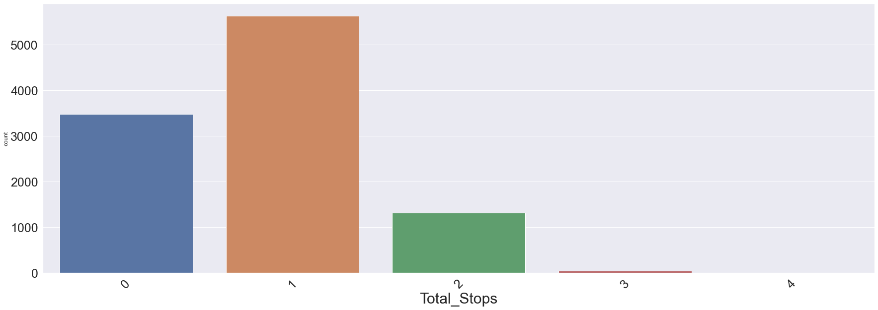
UNIVARIATE ANALYSIS -
Among all airlines, Jet Airways is most frequently used airline.
Majority of flights have only one stop.

Slide 4
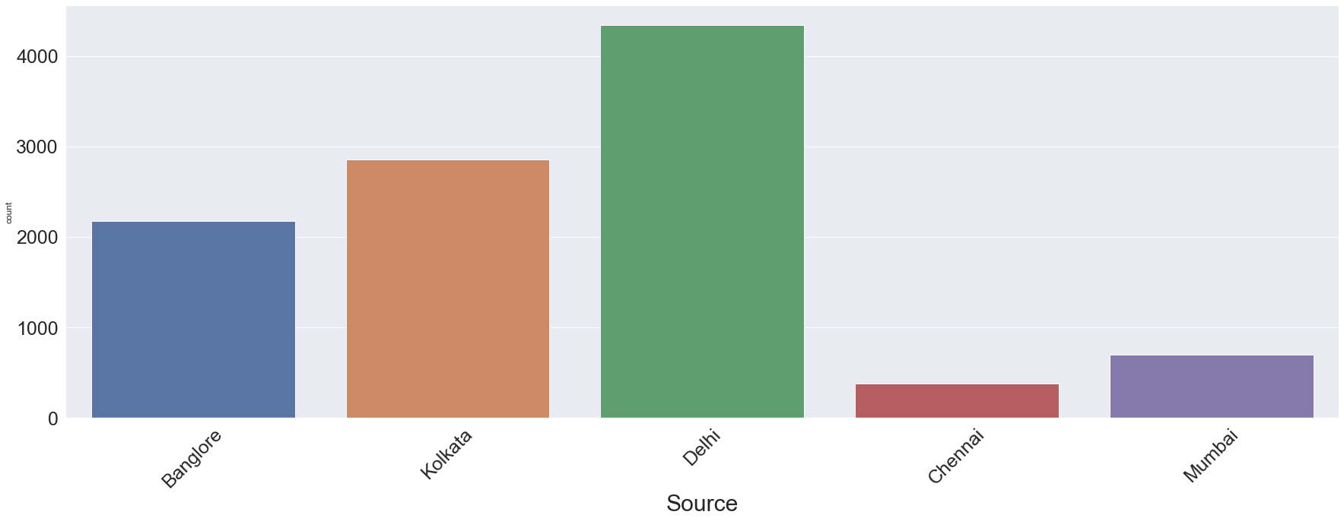
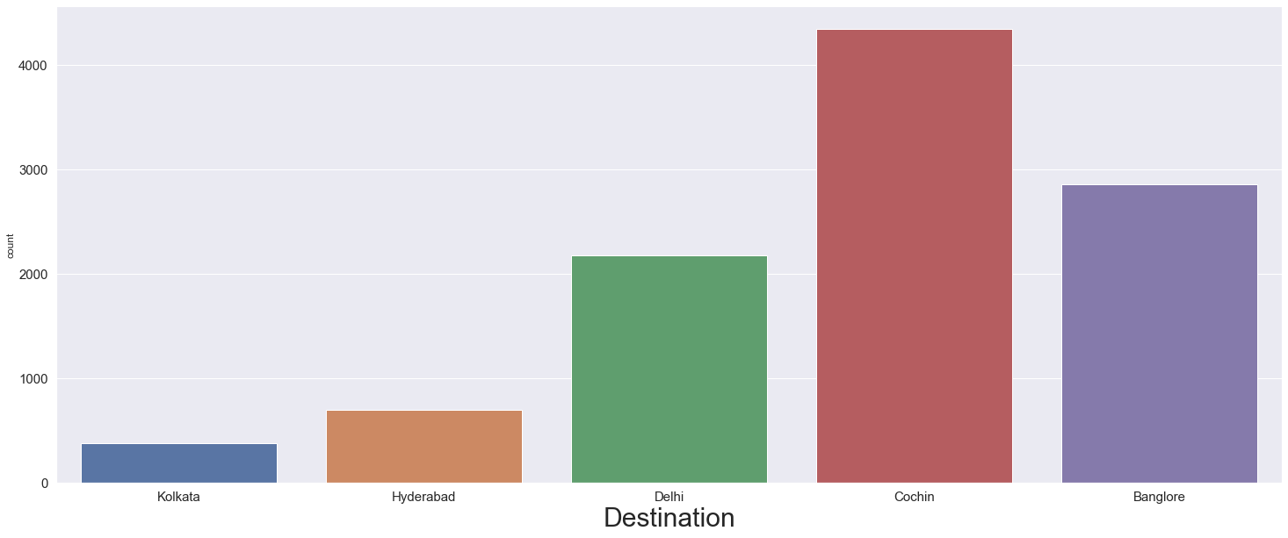
UNIVARIATE ANALYSIS -
Delhi is the place from where majority of flights depart.
Cochin is the destination for most flights.

Slide 5
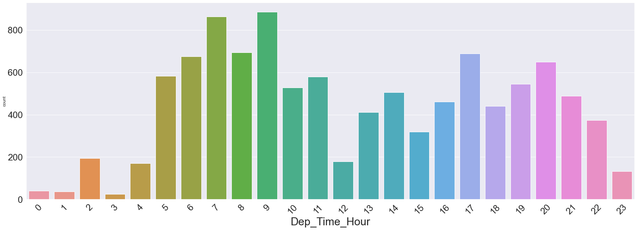
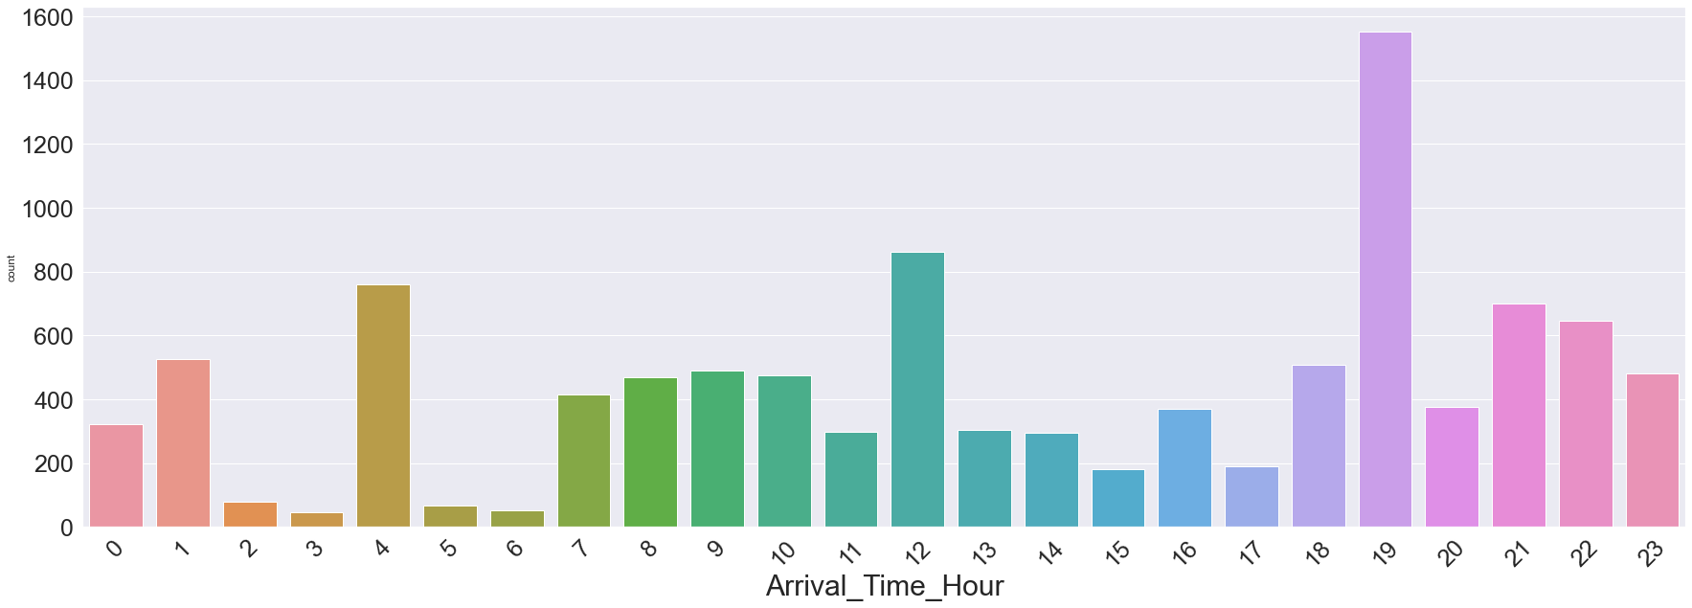
UNIVARIATE ANALYSIS -
In the morning between 5 am and 10 am, majority flights take off.
In the evening majority of flights land, approximately around 7 pm and 10 pm.

Slide 6
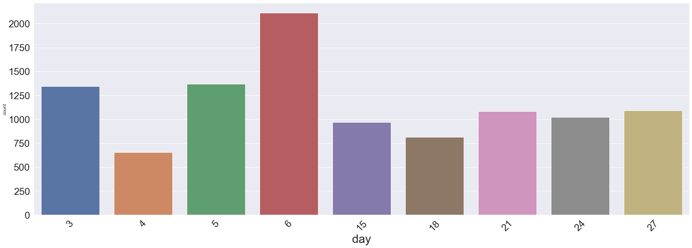
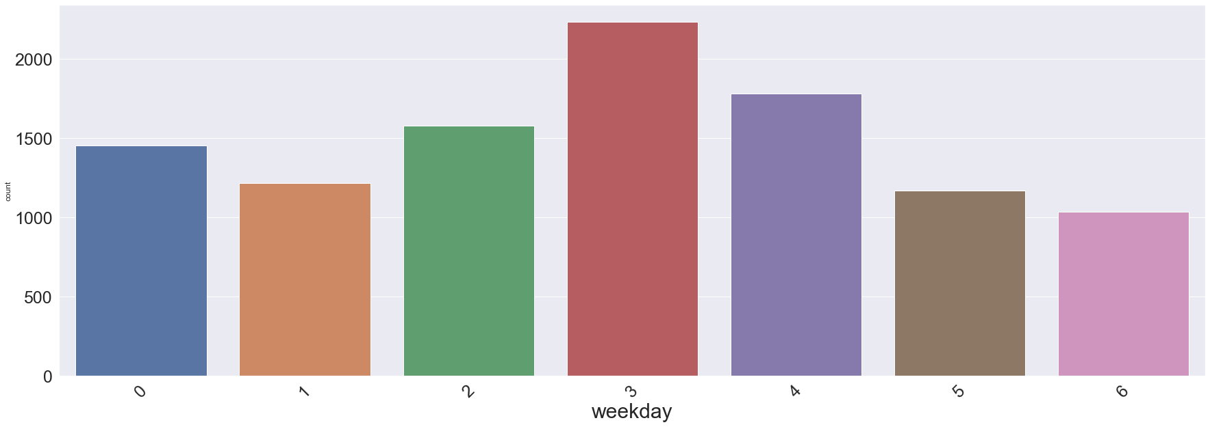
UNIVARIATE ANALYSIS -
Flights are more in first week of month.
Wednesday, Thursday and Friday has highest numbers of flights.

Slide 7
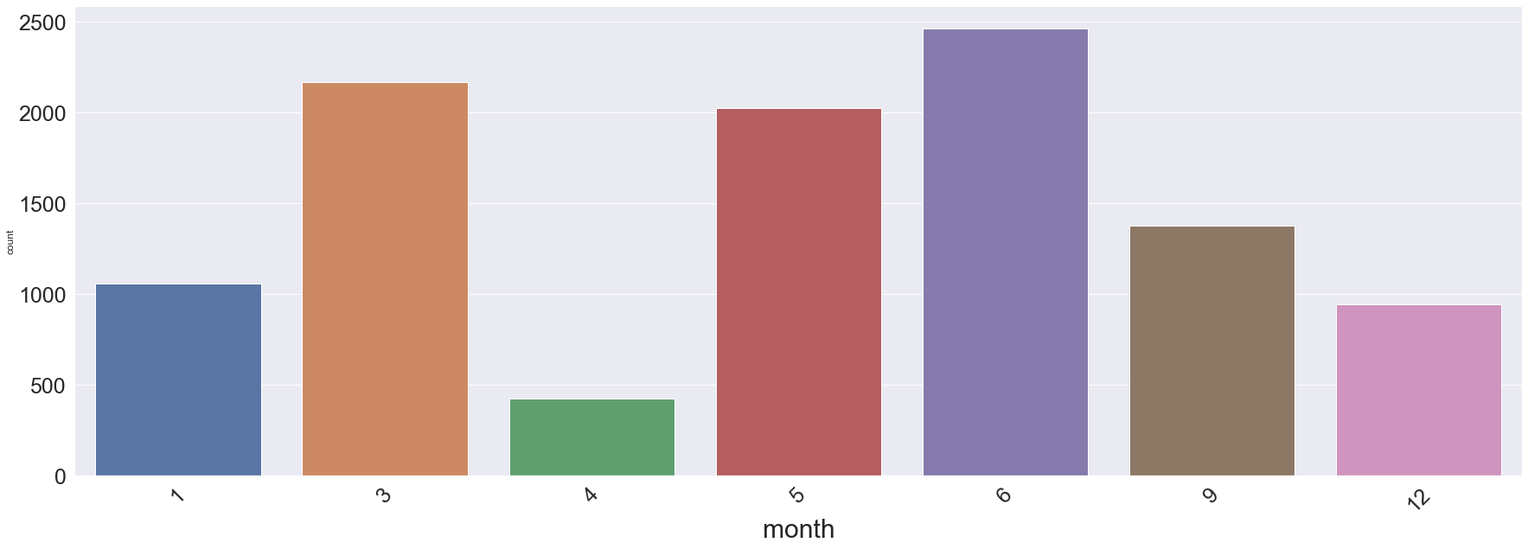
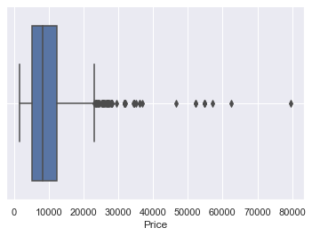
UNIVARIATE ANALYSIS -
March, May and June has highest number of flights.
Price is mostly below Rs 40,000. Outliers are present in Price column, handled it by imputing the median values for price above Rs 40000.

Slide 8
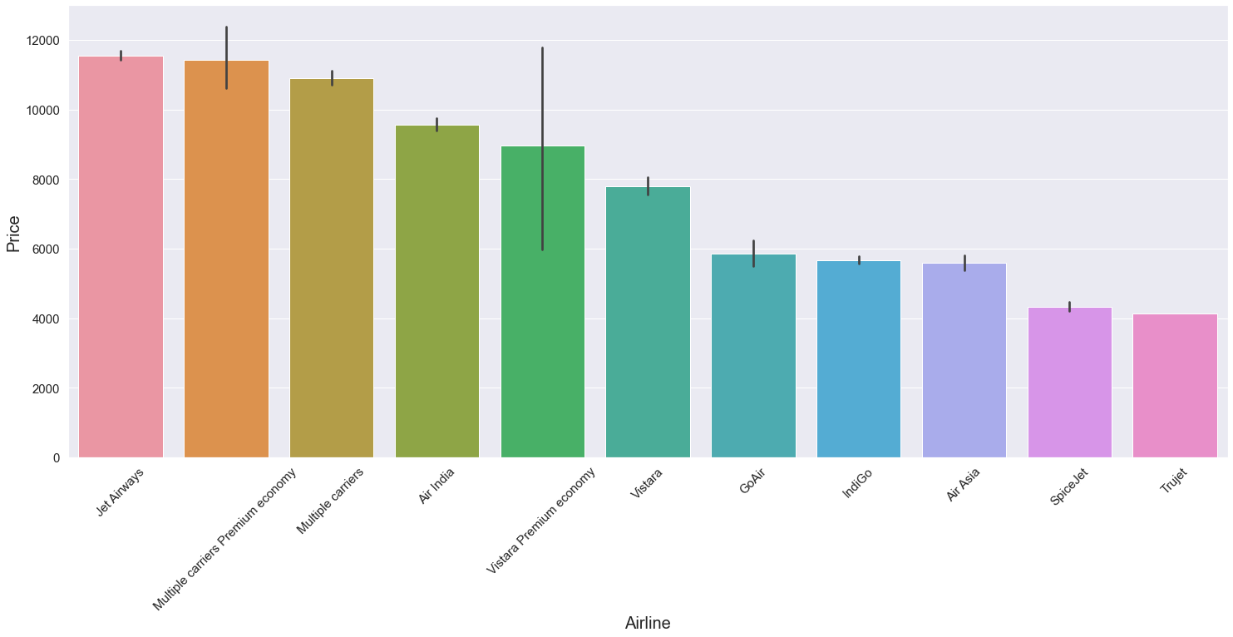
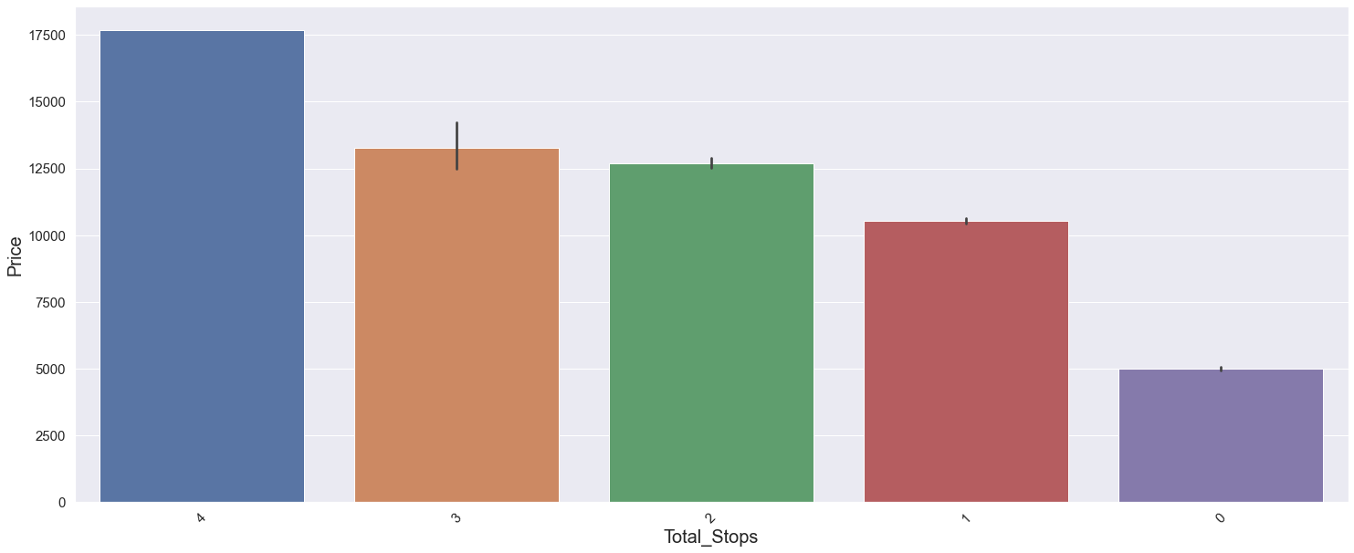
BIVARIATE ANALYSIS -
The average price of Jet Airways and Multiple Carrier Premium Economy is higher than other airlines.
The price of flight is directly proportional to the number of stops.

Slide 9
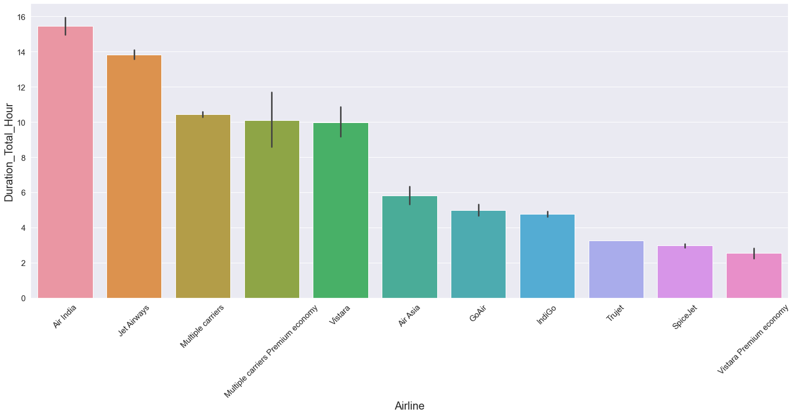
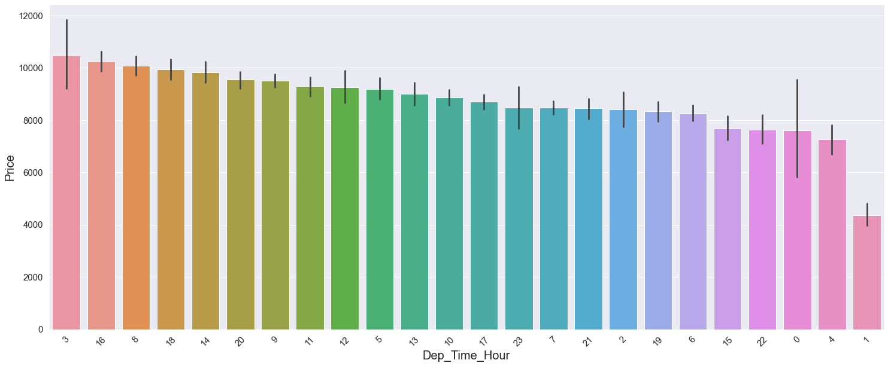
BIVARIATE ANALYSIS -
Air India and Jet Airways have higher duration than other flights.
Price is maximum at 3 am and 4pm. It reduces gradually without any pattern.

Slide 10
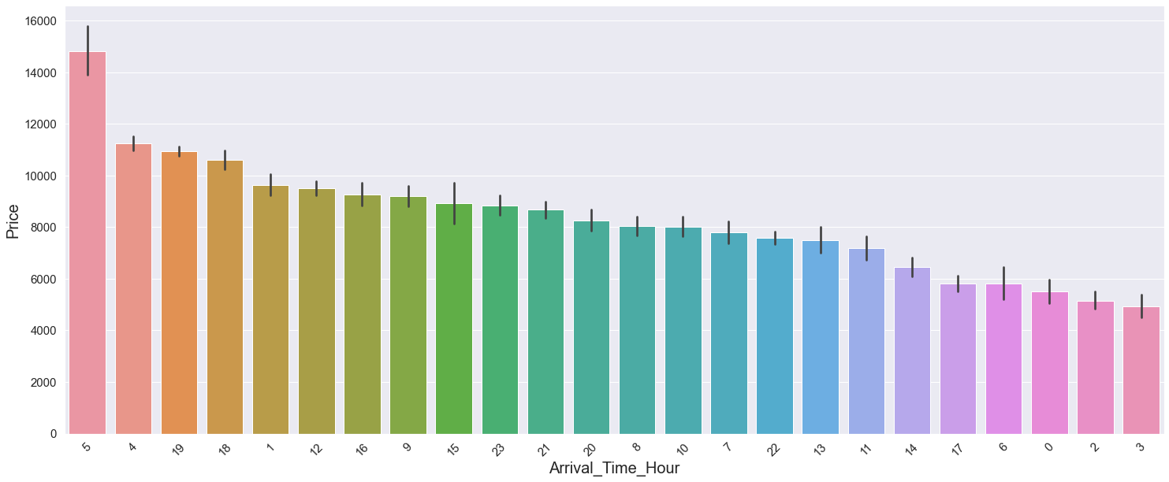
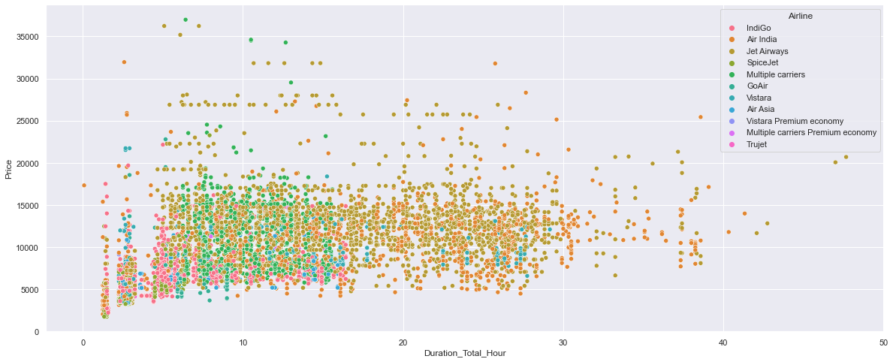
BIVARIATE ANALYSIS -
Price is maximum at 5 am and 4am. It reduces gradually without any pattern.
Plotting price vs duration for airlines shows overlapping hence, no information is extracted

Slide 11
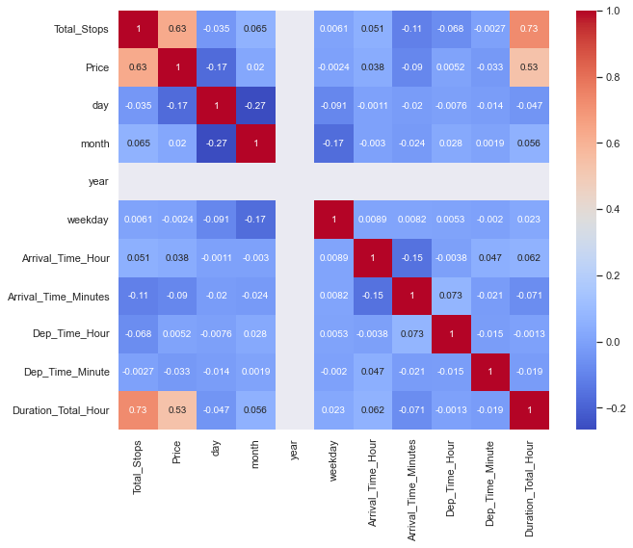
CORRELATION MATRIX -

Slide 12
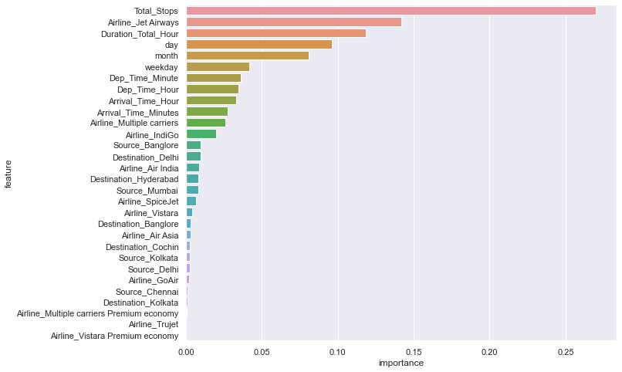
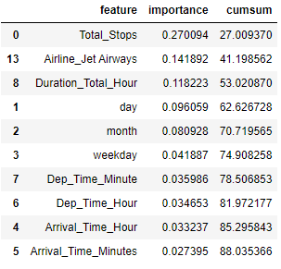
FEATURE IMPORTANCE -

Slide 13
MODEL COMPARISON:
Various algorithms were used, the best performing algorithms were RandomForest and XGBoost.
Lets Compare them:
ALGORITHM | TRAINING SCORE | TEST SCORE | R2 SCORE | MEAN ABSOLUTE ERROR
XGBRegressor | 95% | 82.69% | 82.69% | 1165
Random Forest Regressor | 94% | 80.5% | 80.5% | 2000

Slide 14
FEATURE SCALING EFFECT:
After Normalizing the features, no difference in the outcome was observed in terms of training , test, R2 score.
After Standardizing the features, no difference in the outcome was observed in terms of training and R2 score but test score reduced significantly.
So it can be concluded that scaling has no effect, as majority of features have values (1,0) as compared to numerical features.

Slide 15
CONCLUSION
XGBoost with no scaling can be used to predict the price of the Air Tickets.
It gives best R2 score and Adjusted R2 score of 83% (approx.) and 82.5%(approx.) with least mean absolute error.

